Slide 1

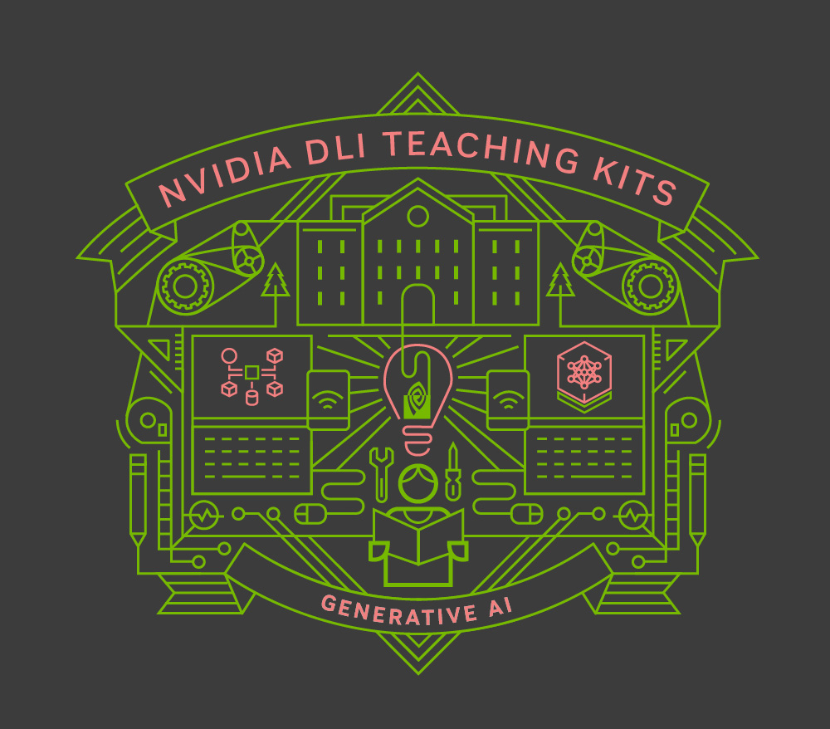
Lecture 6.1- Image Generation and GANs
Generative AI Teaching Kit

Slide 2

The NVIDIA Deep Learning Institute Generative AI Teaching Kit is licensed by NVIDIA and Dartmouth College under the
Creative Commons Attribution-NonCommercial 4.0 International License.

Slide 3
This lecture
Image Generation in the context of Deep Learning and AI
Generating Images
The Convolution and Transpose Convolution
Generative Adversarial Networks (GANs)
Pitfalls and Improvements with traditional GANs, DCGANs
Applications of GANs, StyleGAN, CycleGAN, Conditional GANs

Slide 4
Images & GenAI
Turning our attention to a different medium

Slide 5
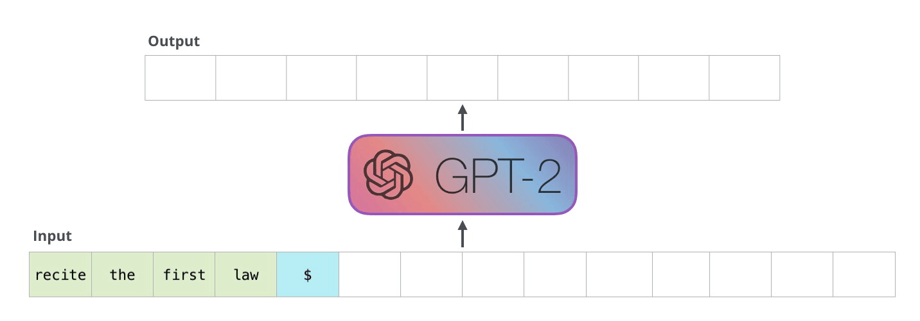
Learning to speak, next to see?
So far in this course we have focused on only text generation with LLMs as the mode of GenAI applications…
But! What about other areas of deep learning beyond Natural Language Processing?
Notes:
https://jalammar.github.io/illustrated-transformer/

Slide 6
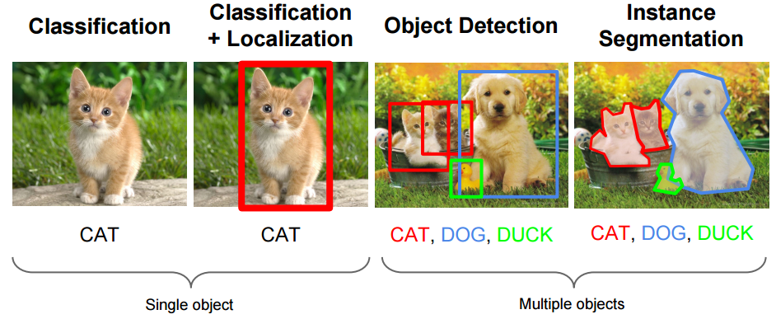
Computer Vision
Prior to the LLM craze, Computer Vision dominated the deep learning world
Whereas Language Models attempt to model and understand human language, vision models focus on interpreting and classifying images (and videos)
However, until recently, generating images was no simple task. Instead the research focused on image comprehension.
Notes:
https://towardsdatascience.com/a-year-in-computer-vision-part-1-of-4-eaeb040b6f46

Slide 7
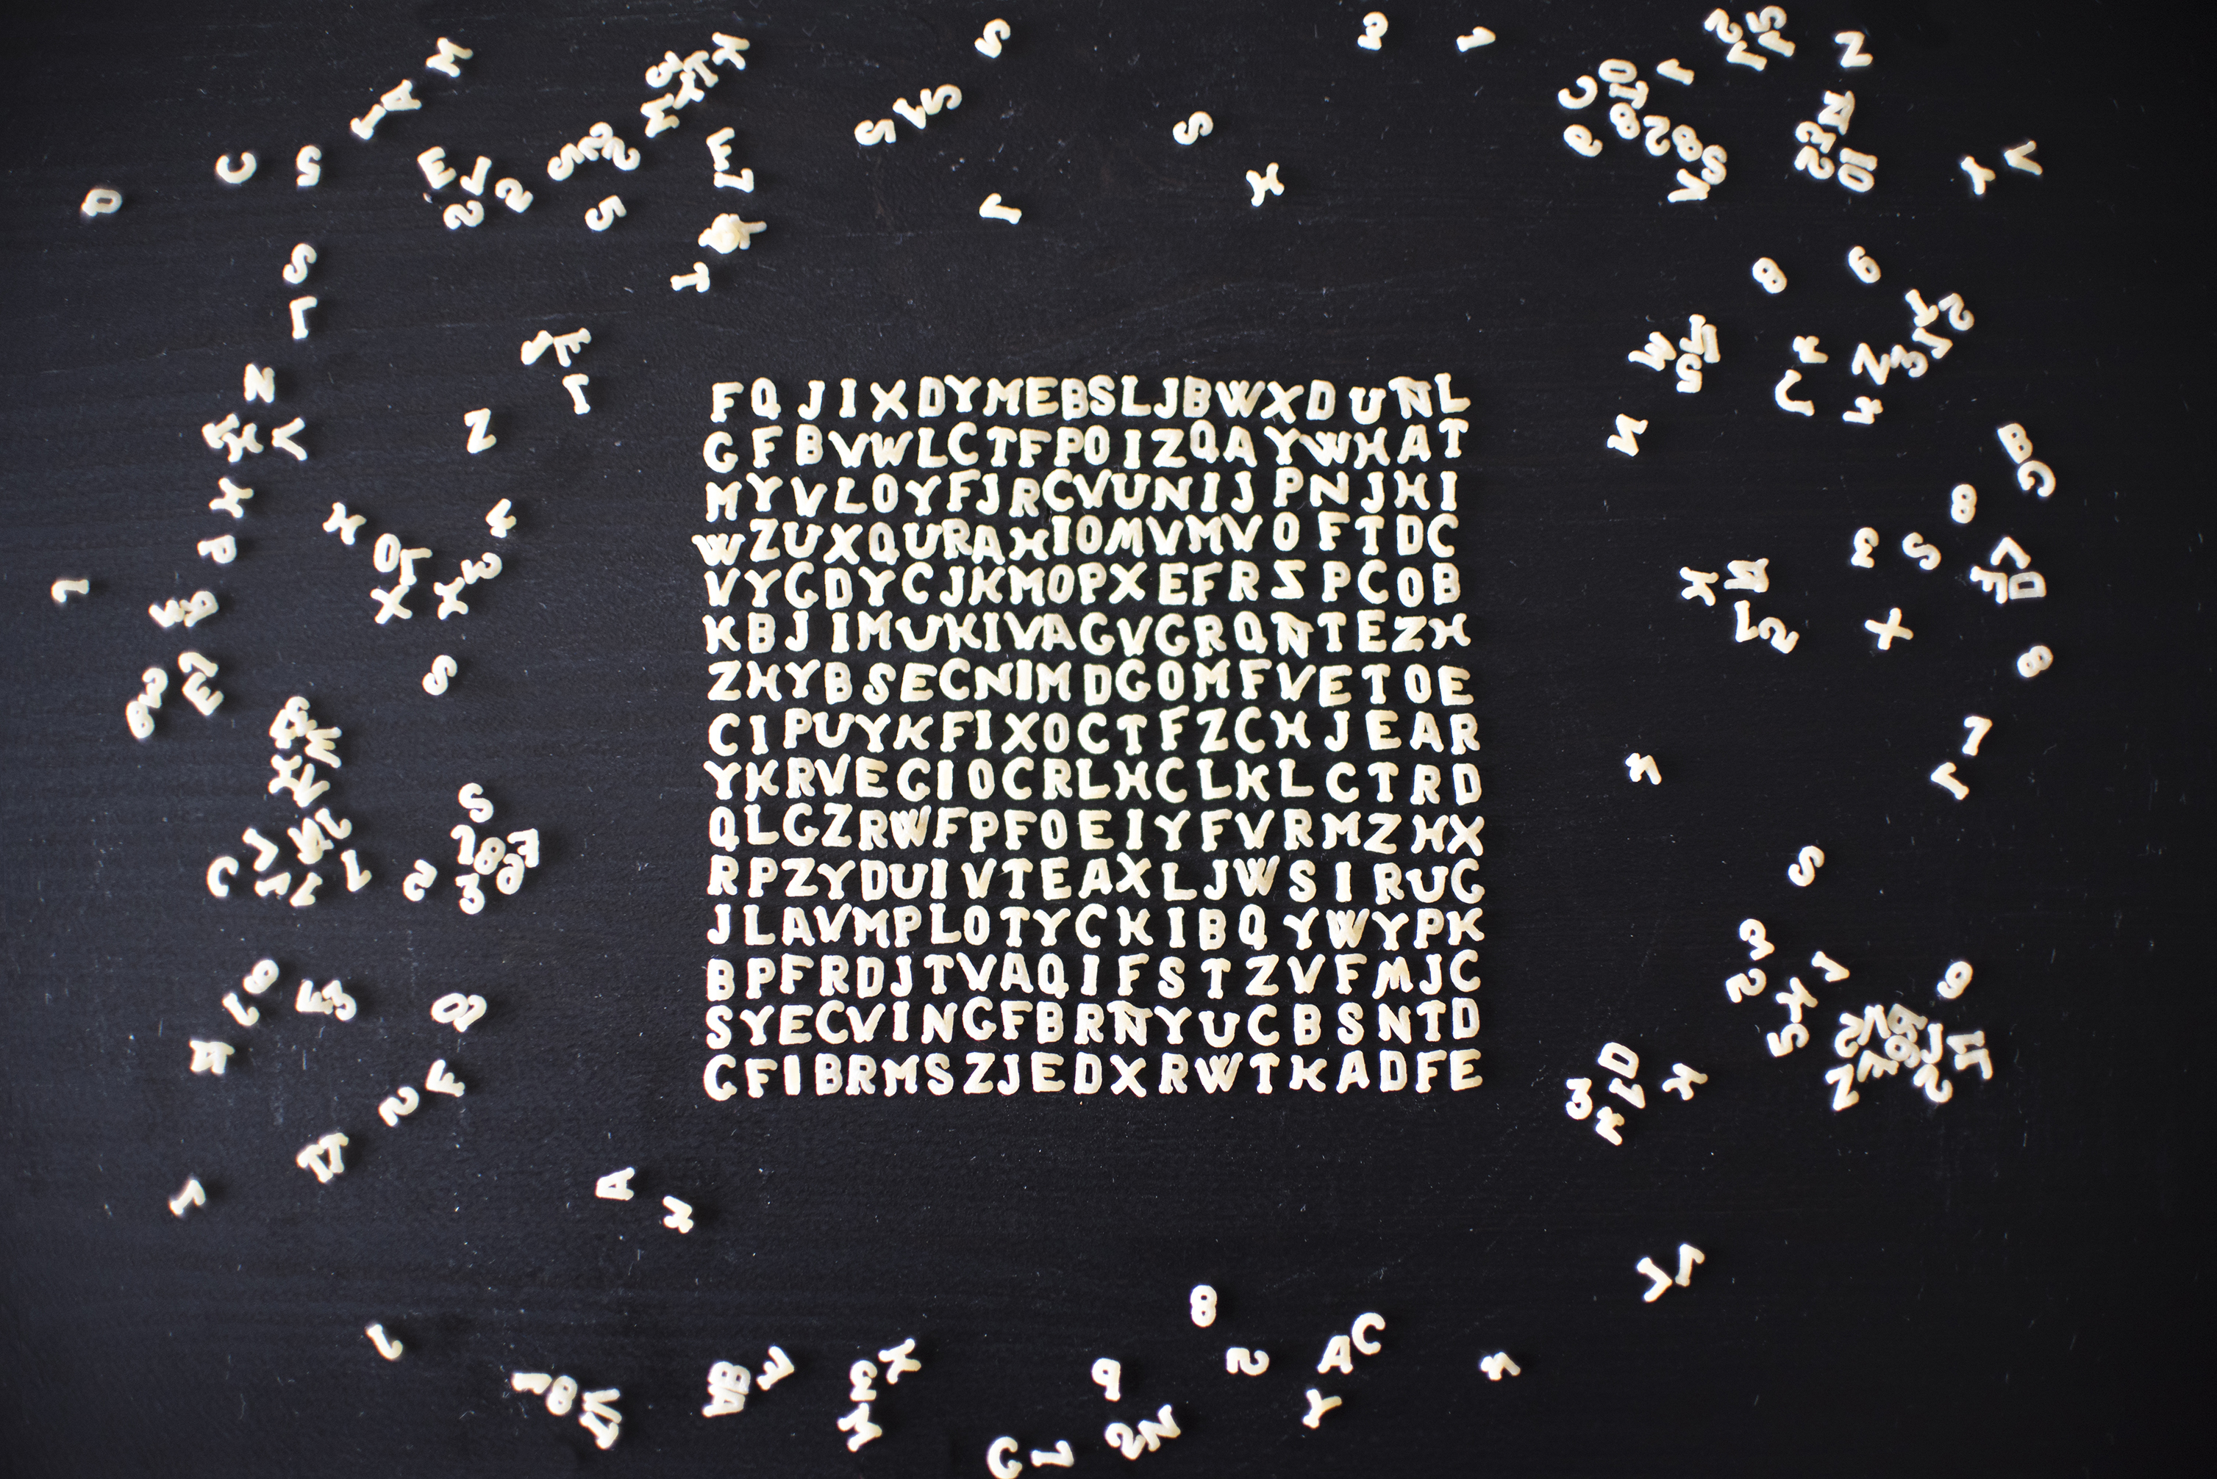
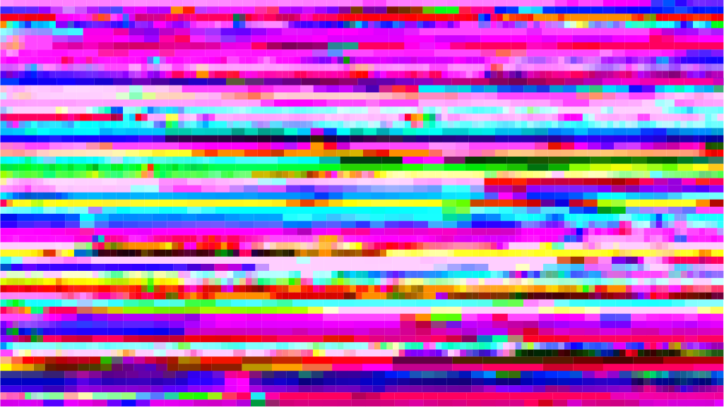
A difficult vision
✅ Language Generation
⬜️ Image Generation?...what is so hard about image generation?
Language has a finite and discrete vocabulary that language models can select from to generate the next token
Images have a continuous multidimensional space from which we can sample, ie an infinite space to search.

Slide 8
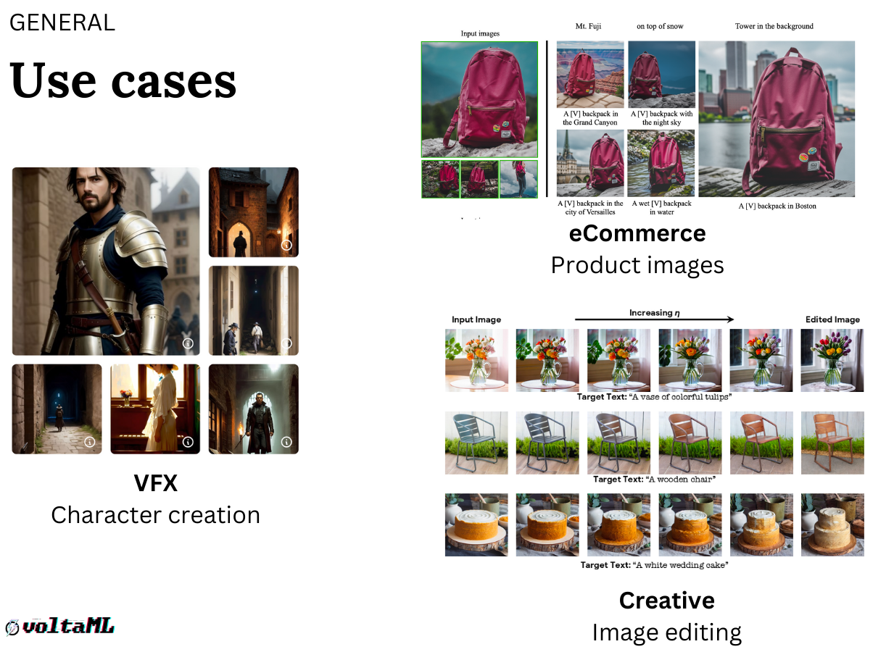
Why generate images in the first place?
We’ve still barely scratched the surface of what image generators can do
Notes:
https://blog.segmind.com/stable-diffusion-deployment/

Slide 9
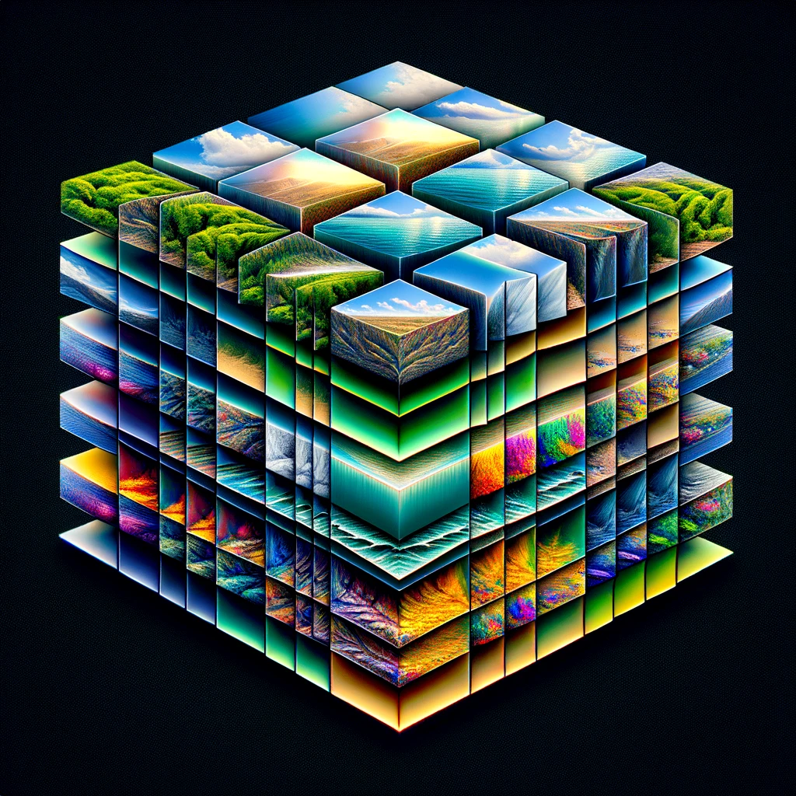
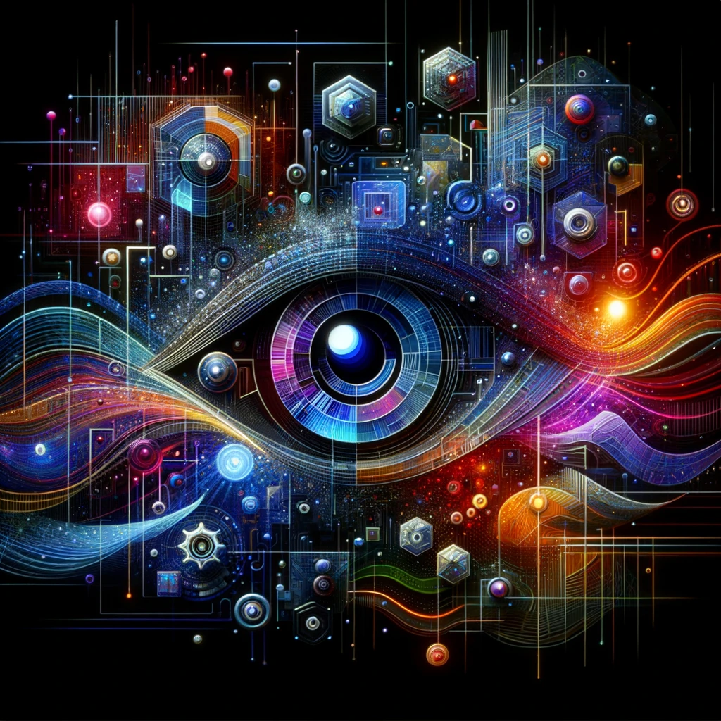
Convolution Layers
How computers see and how they can draw

Slide 10
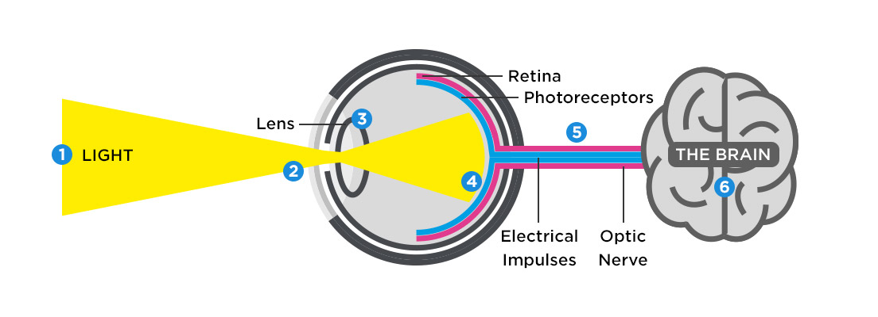
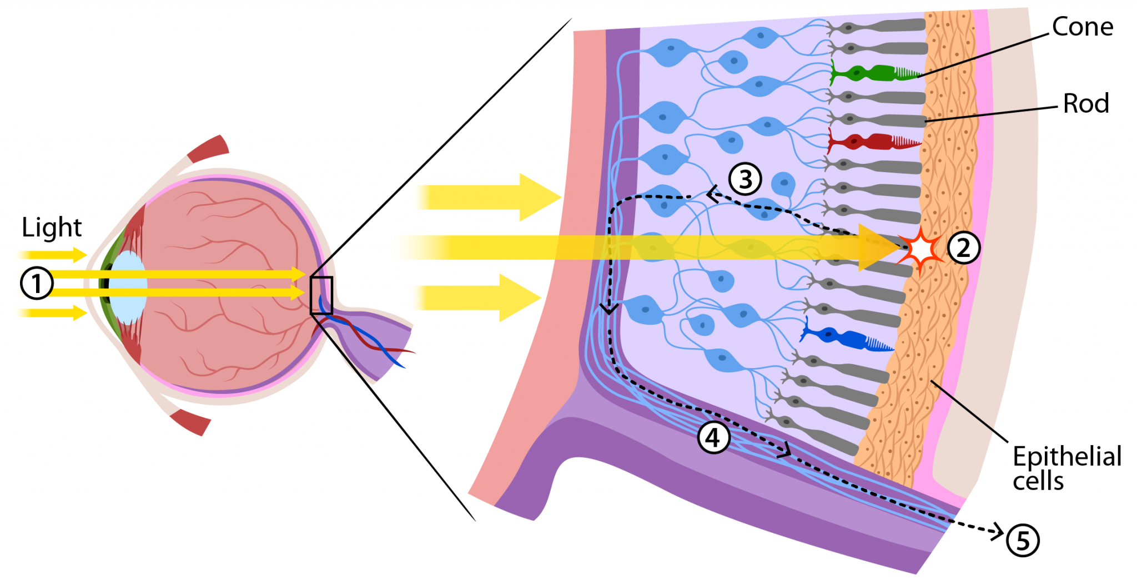
How does sight work?
Rods: Since they are more sensitive to light, rods are responsible for vision at low light levels (scotopic vision). They do not mediate color vision, and have a low spatial acuity.
Cones: Cones are active at higher light levels (photopic vision), are capable of color vision, and are responsible for high spatial acuity.
Notes:
https://tunnellvision.co.uk/how-the-eye-works/
https://askabiologist.asu.edu/rods-and-cones

Slide 11
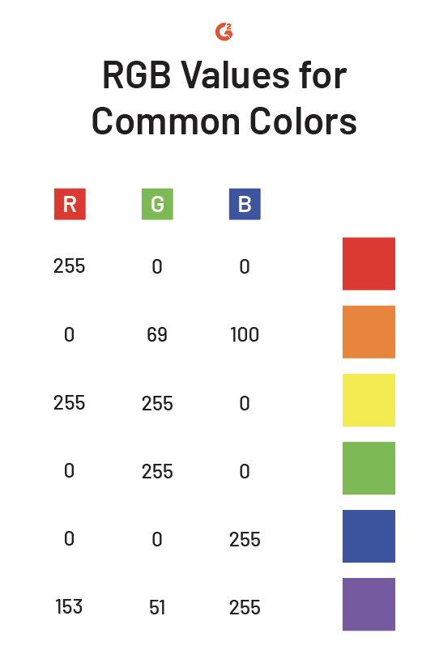
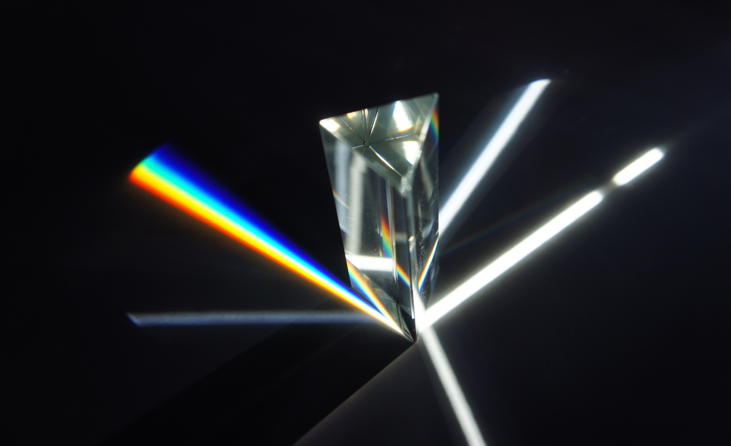
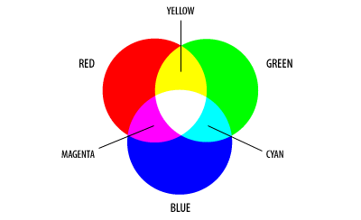
What is a digital image?
Newton’s prism experiment showed that white light is comprised of all colors.
We can represent any visible color as a combination of red, green, and blue.
Notes:
https://en.wikipedia.org/wiki/Prism_(optics)#/media/File:Dispersive_prism.png
https://www.quora.com/What-is-the-difference-between-the-primary-colors-of-light-and-the-primary-colors
https://www.g2.com/articles/rgb-vs-cmyk

Slide 12
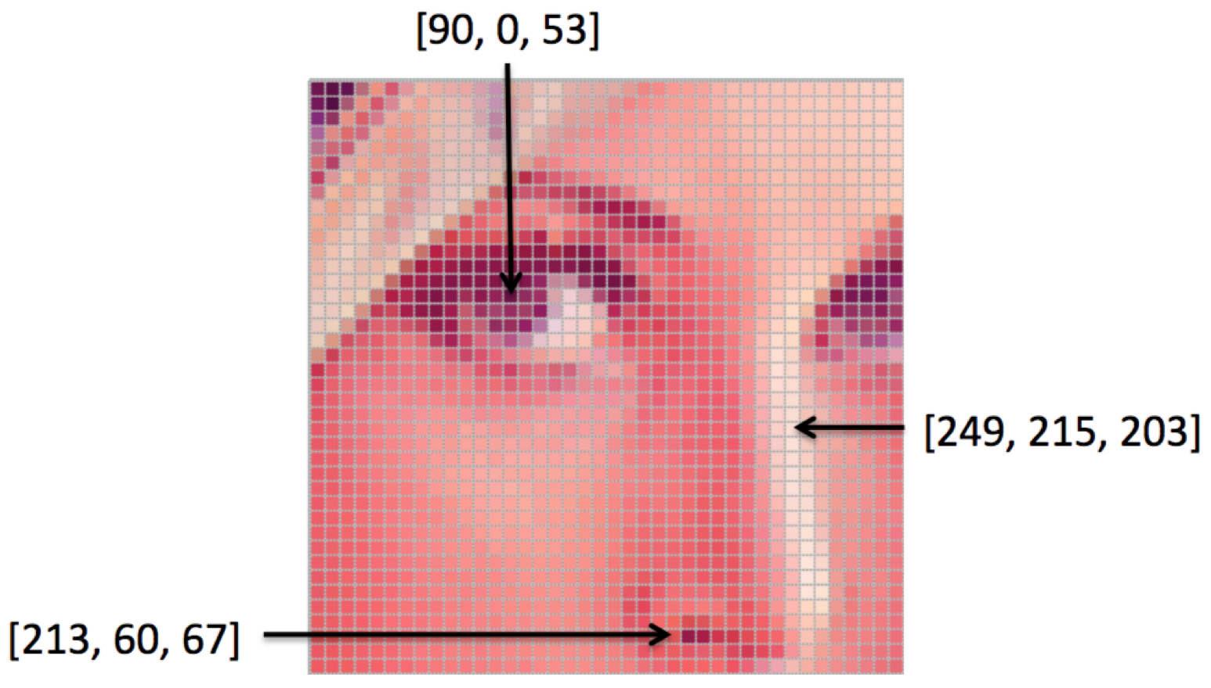
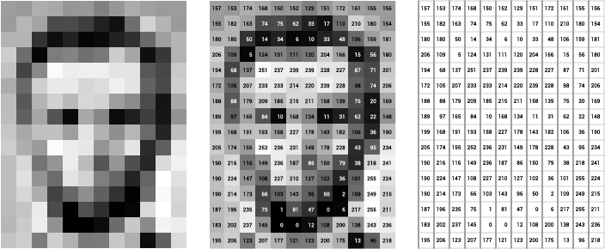
Using numbers to see
Using the RGB ‘color space’ we can store images as a matrix.
Notes:
https://medium.com/@Coursesteach/computer-vision-part-7-4e50b0e8b653
https://datascience.aero/computer-vision-seeing-interpreting-images/

Slide 13
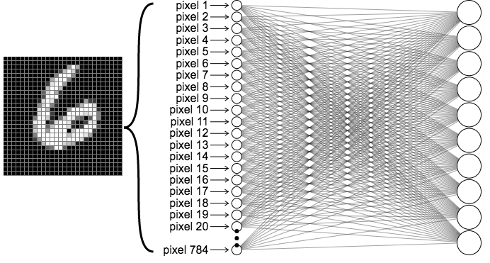
Images but not images
MNIST
The MNIST database (Modified National Institute of Standards and Technology database) is a large database of handwritten digits that is commonly used for training various image processing systems since 1994.
Prior to the convolution layer, images like MNIST were flattened to a list of pixel values.
This method did not work for the ImageNet competition…. why?

Slide 14
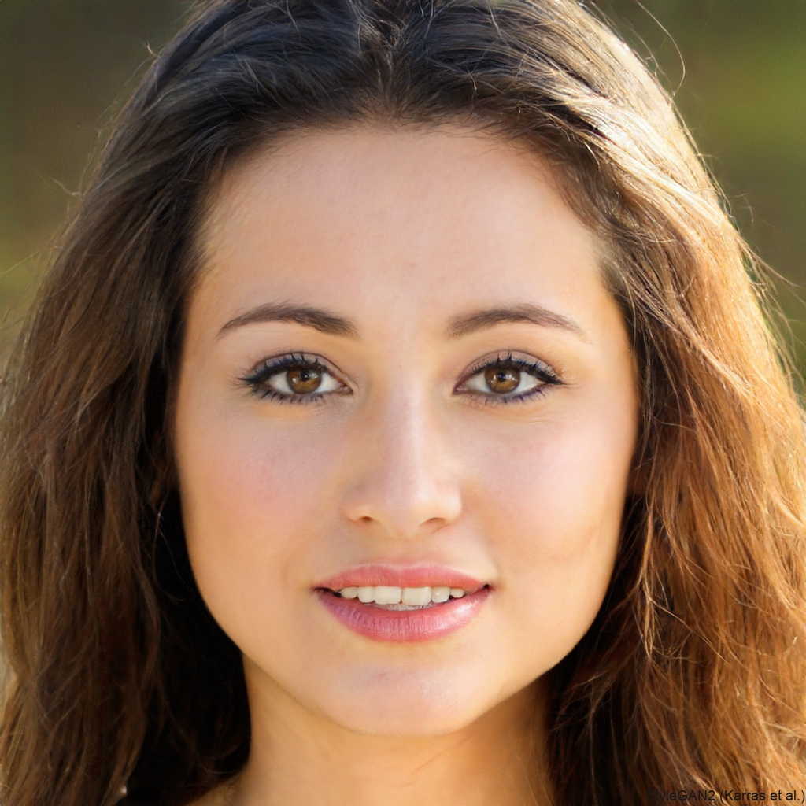
Spatial Information
Simple neural networks see inputs independently.
Images, however, have a lot of local spatial dependency/local connectivity.
Think about facial recognition:
Distance between the eyes
Distance from the forehead to the chin
Distance between the nose and mouth
Depth of the eye sockets
Shape of the cheekbones
Contour of the lips, ears, and chin
We need something that can process spatial information
https://thispersondoesnotexist.com/

Slide 15
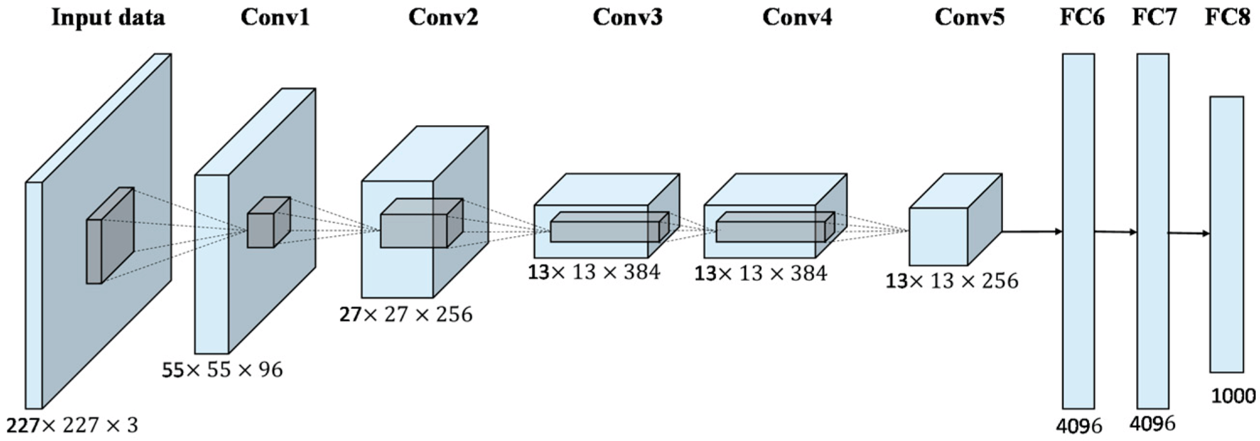
The CNN revolution - AlexNet
The neural network AlexNet won the 2012 ImageNet competition
This was the first mainstream utilization of a Convolutional Neural Network and would shape the next decade of AI research and development.
AlexNet won with a top-5 error rate of 15.3%, compared to the second-place top-5 error rate of 26.2%.
Notes:
https://papers.nips.cc/paper_files/paper/2012/file/c399862d3b9d6b76c8436e924a68c45b-Paper.pdf

Slide 16
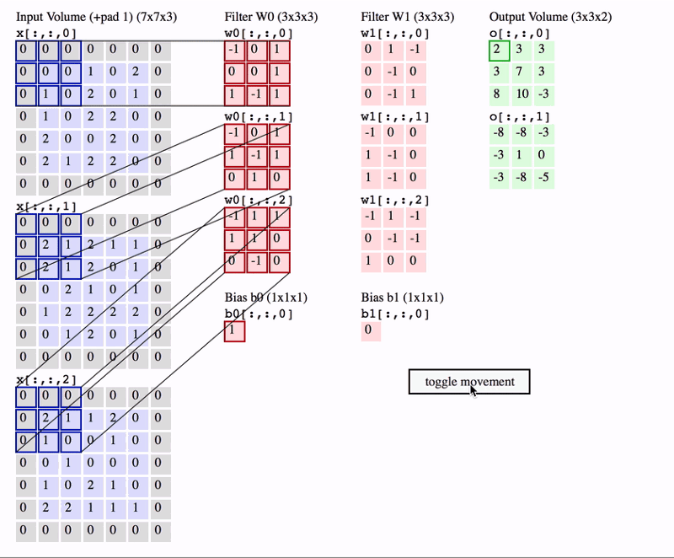
Secret to success: The Convolution Operation
The convolution operation is the key to computer vision, and allows for image generation too
A convolution layer uses a set of kernels to perform convolutions over the image.
Typical sizes are 3x3 and 5x5. The kernels are learned in training.
Being able to span vertical and horizontal directions to gather information, these kernels can interpret spatial information very effectively and efficiently.
Notes:
https://cs231n.github.io/

Slide 17
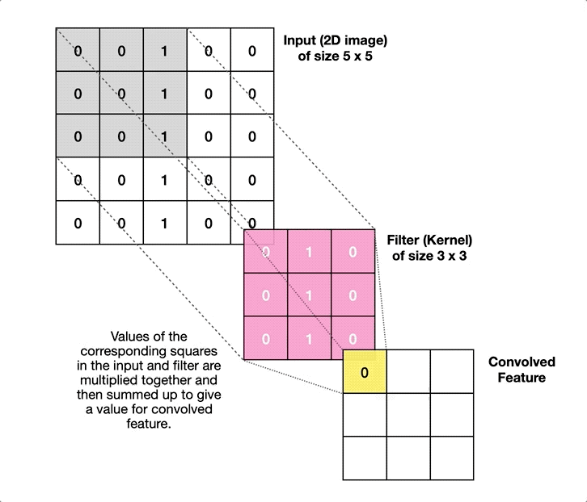
Going the other direction?
Convolution Layers are used to distill parts of the image into a lower dimensional representation of the image
Information is lost at each state of a convolution, so a direct reversal would not generate the same image
But if we allow for some “fuzziness” in the generated image, we can flip the flow of information to expand the dimension of the data
Notes:
https://towardsdatascience.com/transposed-convolutional-neural-networks-how-to-increase-the-resolution-of-your-image-d1ec27700c6a

Slide 18
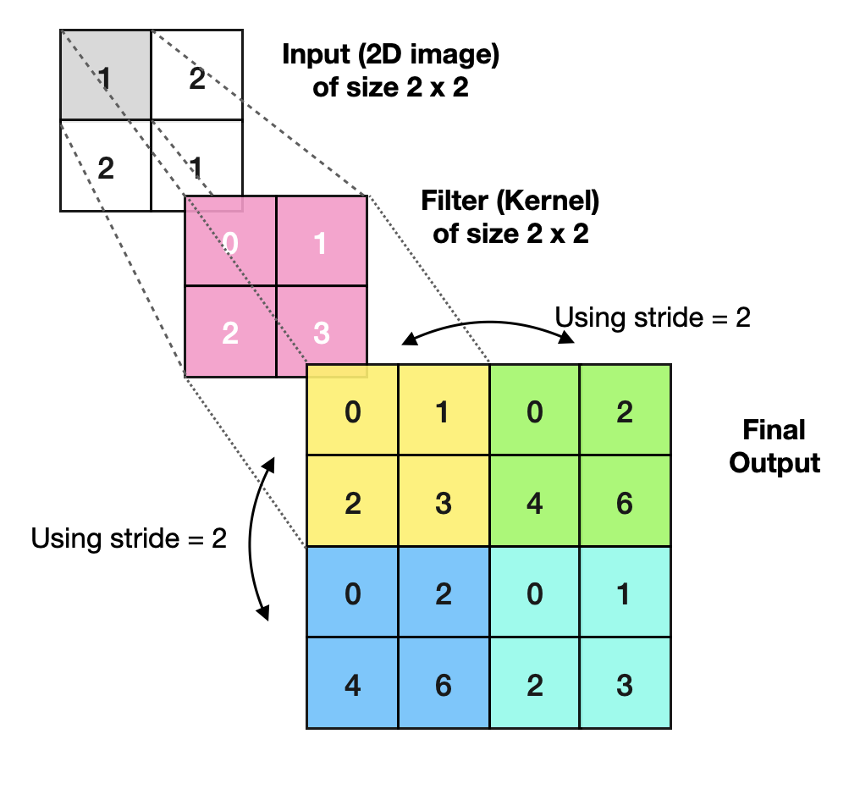
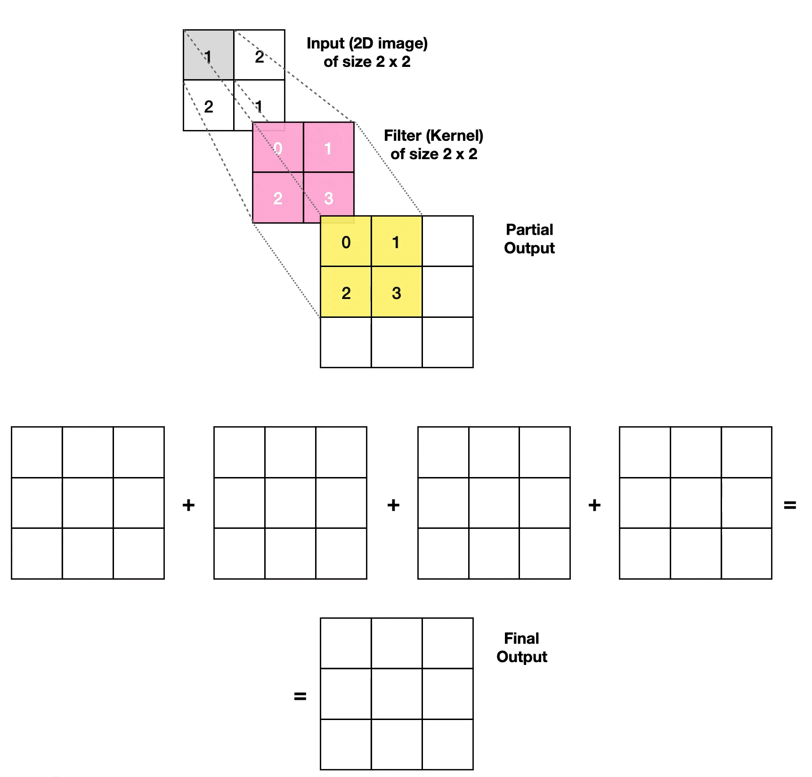
The Transpose Convolution
The process involves using a kernel and a stride to slide over the input tensor.
Transpose convolutions do not combine multiple input values into a single output (as in standard convolution).
Instead, it spreads a single input value across multiple output positions, effectively increasing the spatial dimensions.
Notes:
https://towardsdatascience.com/transposed-convolutional-neural-networks-how-to-increase-the-resolution-of-your-image-d1ec27700c6a

Slide 19
Generative Adversarial Networks
Generative AI before “GenAI”

Slide 20
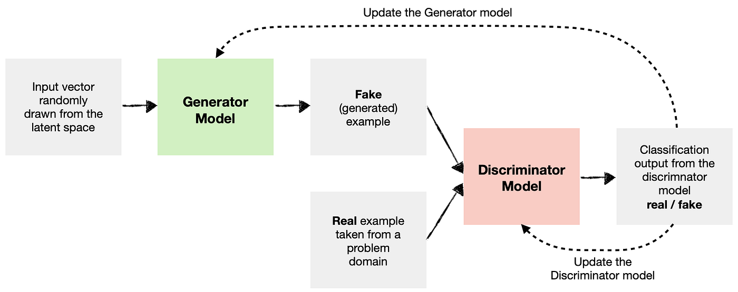
Generative Adversarial Networks - What is a GAN?
The GAN was originally proposed by Ian Goodfellow in 2014 in which two neural networks contend against each other, hence “adversarial”
The Generator model, G, takes as input a random vector, Z, and is trained to generate some data.
The Discriminator model, D, is a classifying whose sole role is to determine if a sample came from the training dataset, or is a fake generated by G.
Z
G
D
When trained, we can smoothly vary the input vector Z to generate new samples
Notes:
https://towardsdatascience.com/gans-generative-adversarial-networks-an-advanced-solution-for-data-generation-2ac9756a8a99

Slide 21
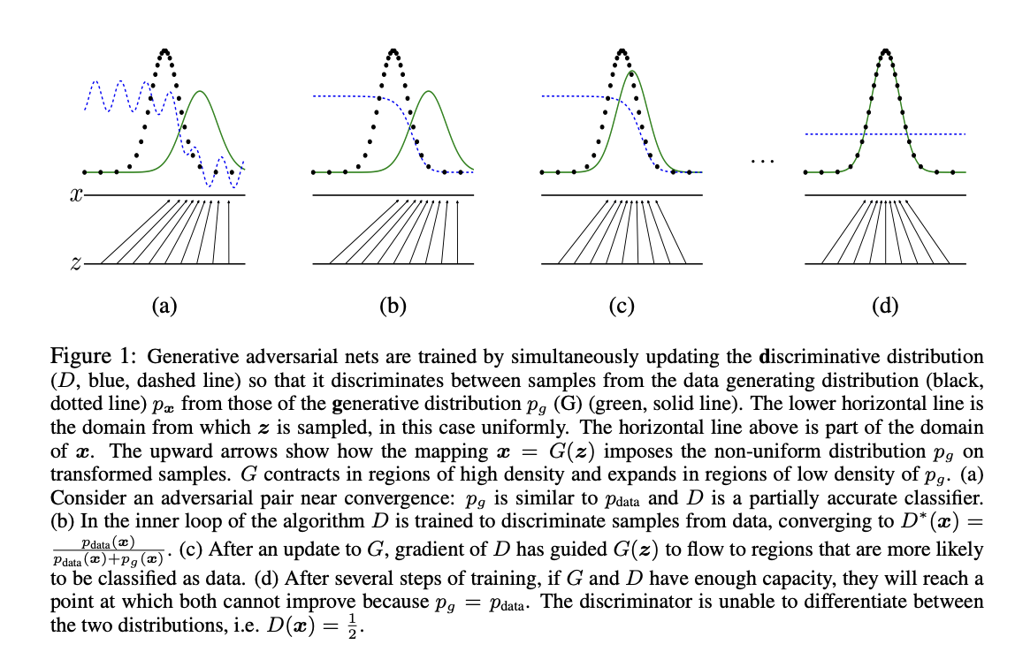
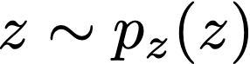
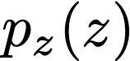
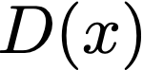

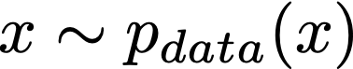
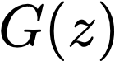
Generative Adversarial Networks – Training a GAN
Training GANs couples the Generator and Discriminator losses
From the original GAN paper
The generator generates synthetic data from random noise,
Where is a prior distribution (e.g., uniform or normal distribution).
The discriminator outputs a probability indicating whether input, , is real or fake.
is trained to maximize the probability of correctly classifying real data
, and synthetic data,
Generator Loss
The Generator tries to maximize the log-likelihood of synthetic data being classified as real.
Discriminator Loss
The Discriminator tries to maximize the log-likelihood of real data being classified as real and synthetic data being classified as fake.
Notes:
https://arxiv.org/abs/1406.2661

Slide 22
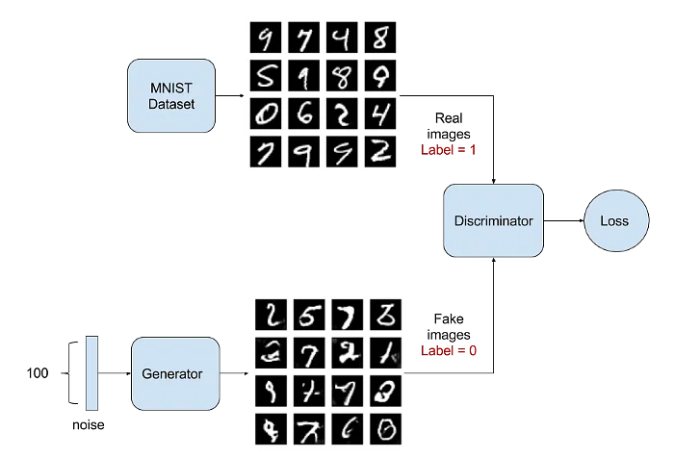
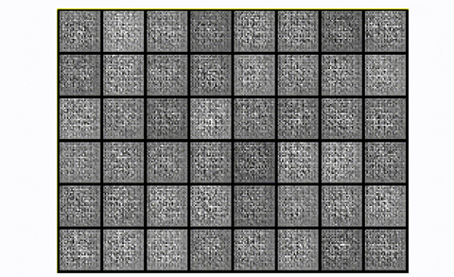
Generative Adversarial Networks – Creating Images
GANs can generate essentially any form of data.
For the MNIST problem, GANs can produce a flat array of 0s and 1s.
Progression of generating MNIST examples as a GAN is trained
Notes:
https://www.projectpro.io/article/generative-adversarial-networks-gan-based-projects-to-work-on/530

Slide 23
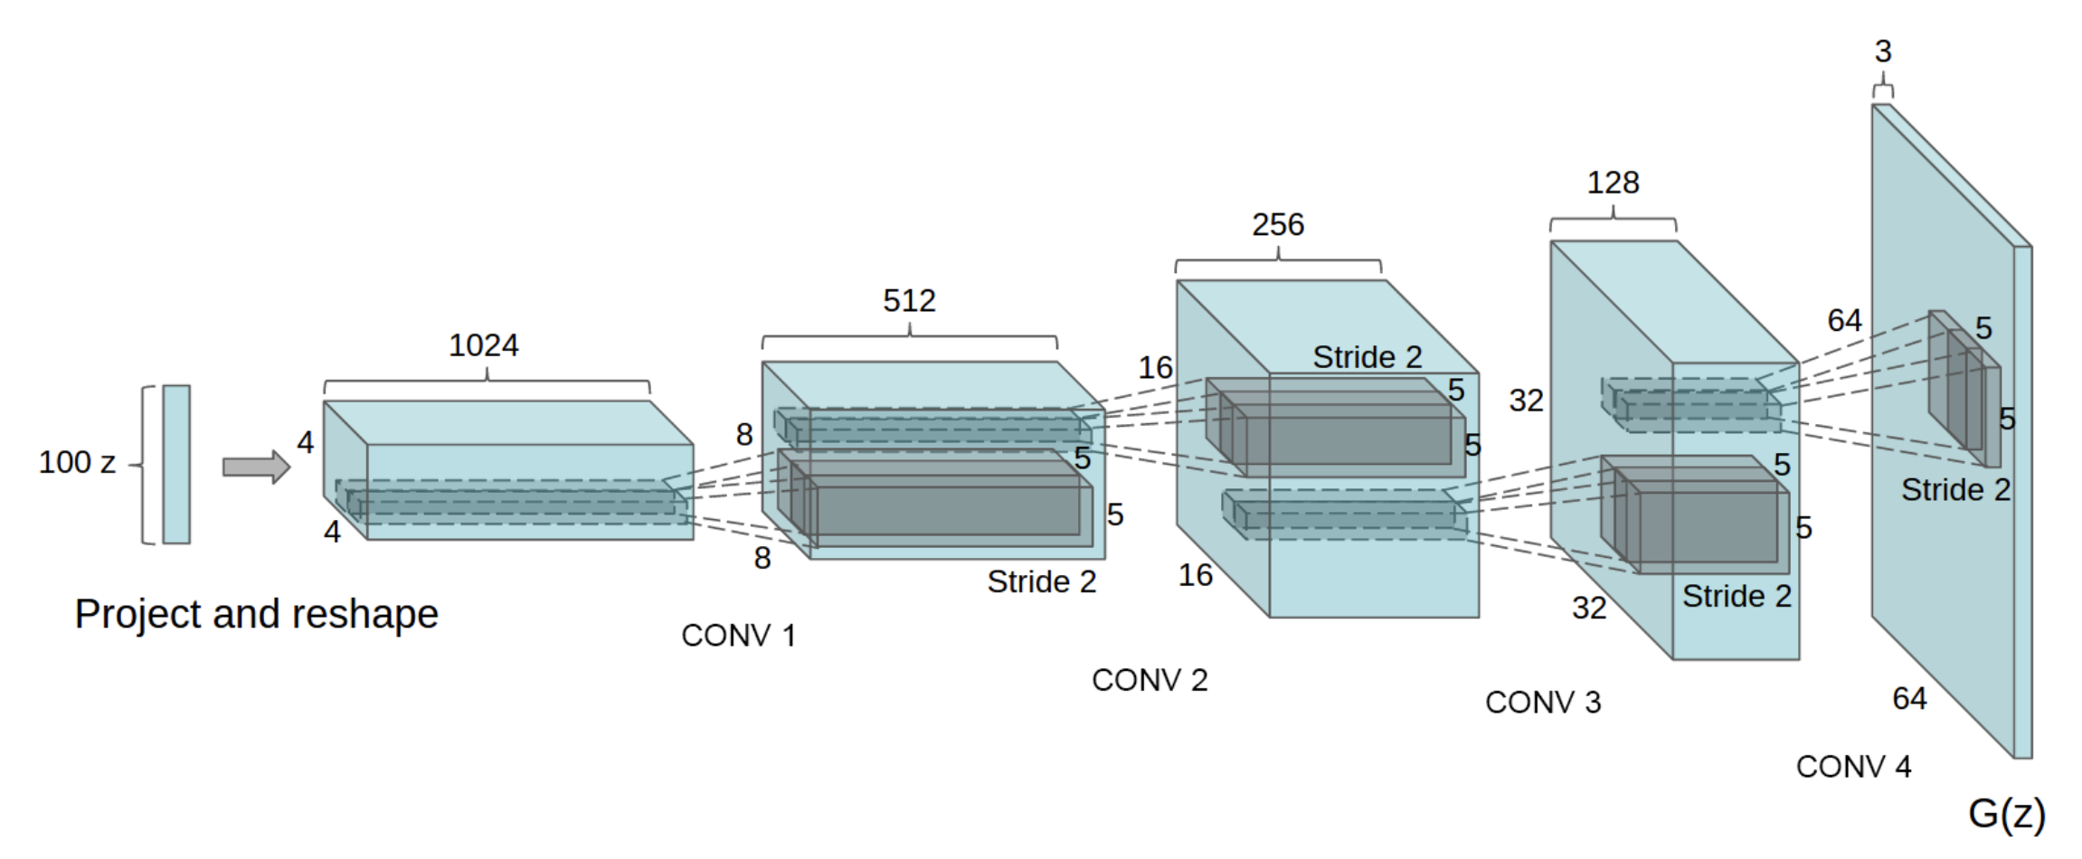
Generative Adversarial Networks – Deep Convolution GANs
Recall that we have seen the transpose convolution. We can create a new type of generator, one that includes these transpose convolution.
DCGAN (Deep Convolution GAN)
Input a random column vector
Passed through several transpose convolutions
Final result is a generated image!
Original DCGAN architecture
Notes:
https://arxiv.org/abs/1511.06434v2

Slide 24
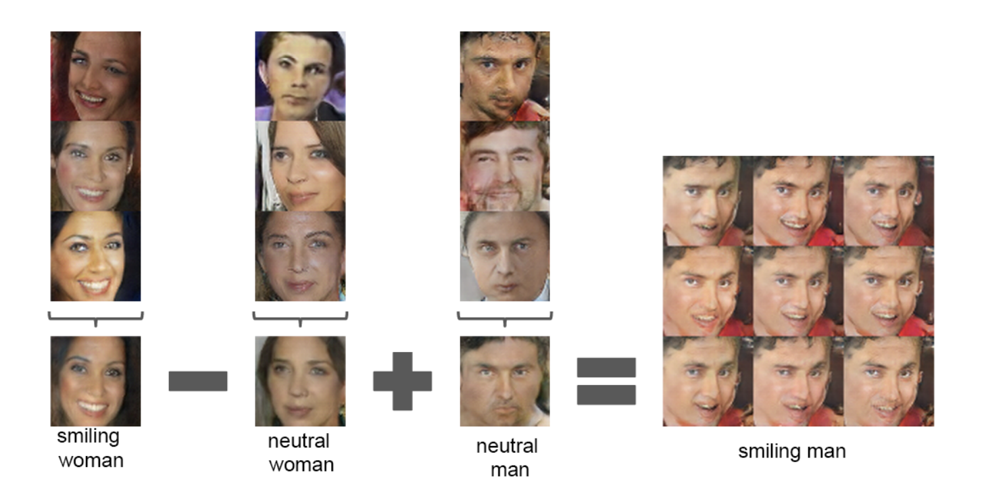
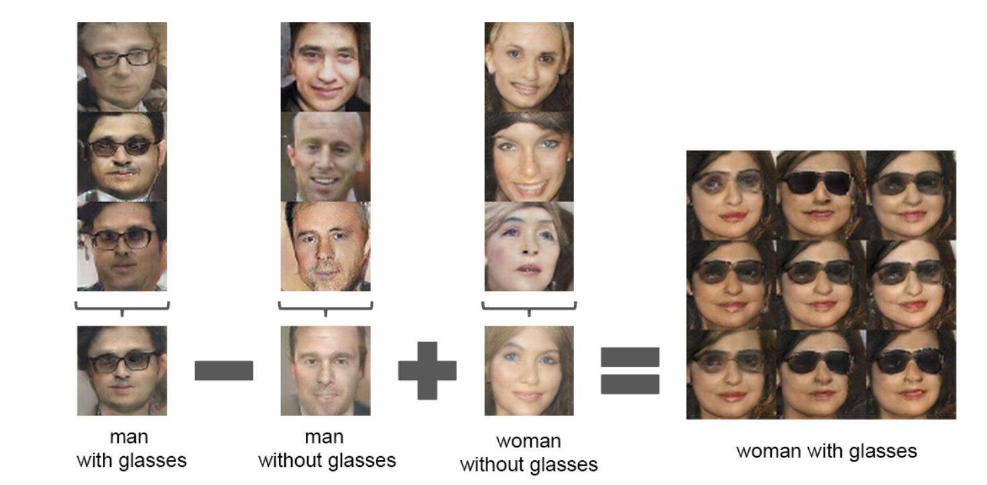
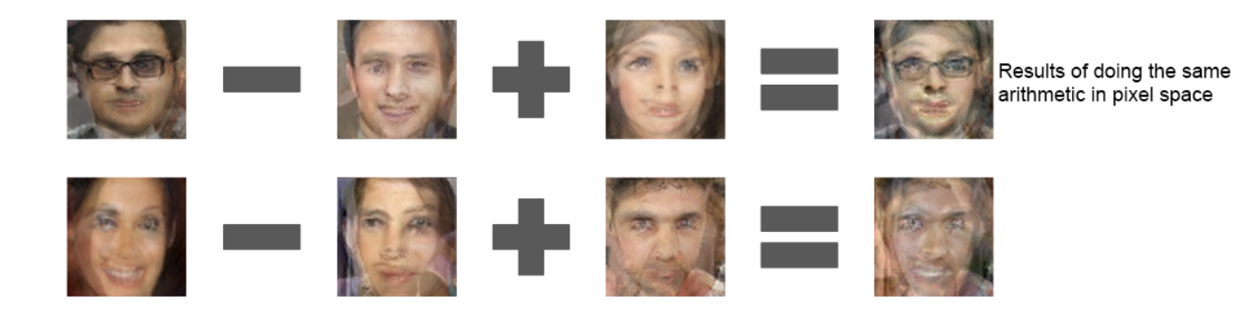
DCGAN – Exploring the latent space of images
With a trained DCGAN, we can manipulate the latent vector, z, to explore the space of images we can generate.
Latent Vector Space (adding the z vectors)
Pixel Space (adding the pixel values)
Notes:
https://arxiv.org/abs/1511.06434v2

Slide 25
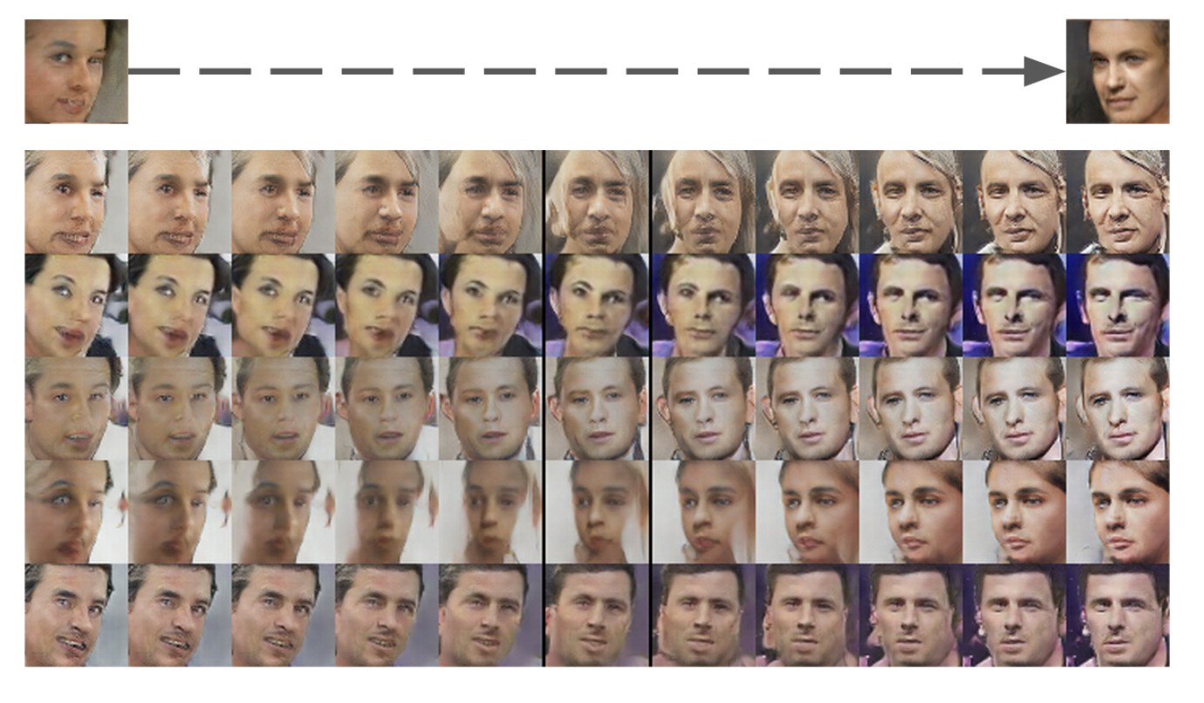
DCGAN – Exploring the latent space of images
By carefully controlling how we change the latent vector, we can even reliably control the image changes.
Here the authors discovered how to induce a turn in the image subject by finding a “turn vector to add to the latent vector
Notes:
https://arxiv.org/abs/1511.06434v2

Slide 26
Improvements and Challenges of GANs
Training GANs can be especially adversarial…

Slide 27
Generative Adversarial Networks – Issues and Challenges
Training Instability:
GANs are notoriously difficult to train, often suffering from issues like mode collapse and vanishing gradients.
Hyperparameter Sensitivity:
The performance of GANs is highly sensitive to the choice of hyperparameters, requiring extensive tuning.
Lack of Interpretability:
GANs are considered black-box models, making it hard to understand the internal workings and learned features.

Slide 28
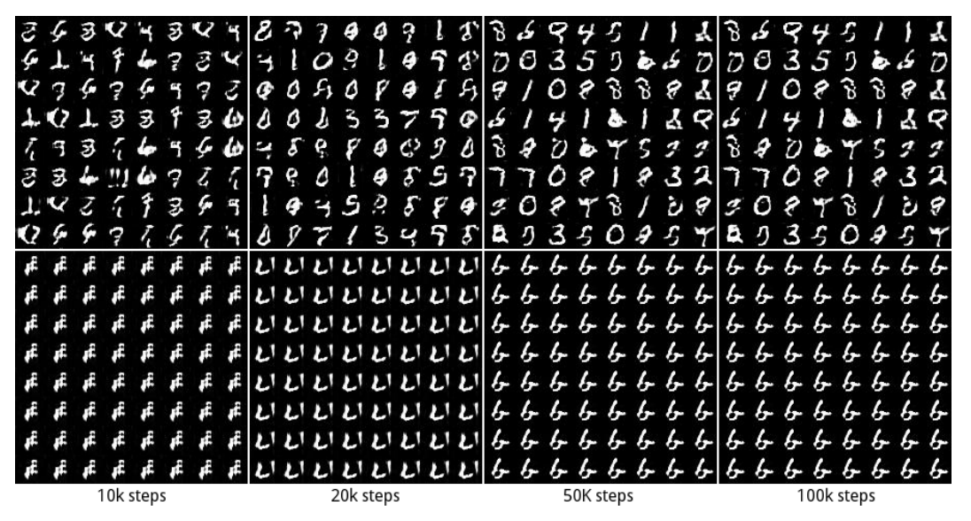
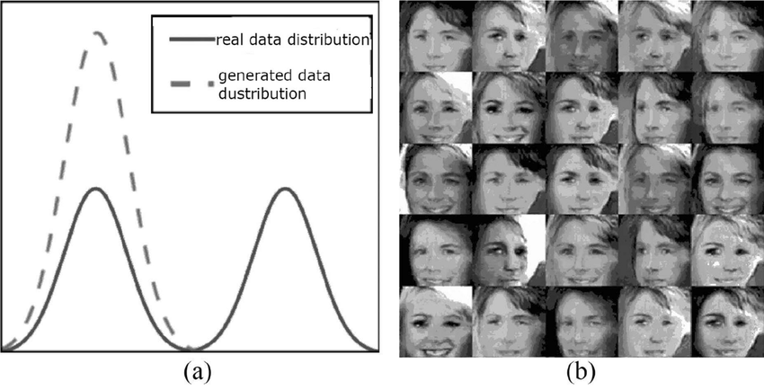
Generative Adversarial Networks – Mode Collapse
During training a Generator can find a local minima which produces strong feedback from the discriminator.
After this point, there is little or no impetus for the Generator to try new examples.
This collapse into a single output is known as Mode Collapse
Mode Collapse Desired
Generator gets stuck in a subset of the distribution that passes the discriminator
Notes:
https://arxiv.org/pdf/1611.02163
https://link.springer.com/article/10.1007/s12065-021-00665-z

Slide 29
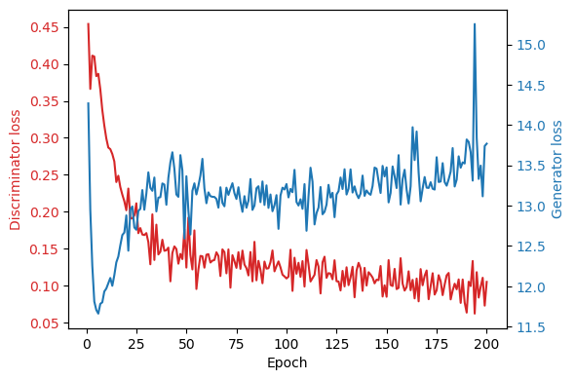
Generative Adversarial Networks – Instability
Another challenge of GAN training is instability, consider the following:
Generator improvement leads to discriminator decline.
Perfect generator results in 50% discriminator accuracy (coin flip).
Convergence issue: discriminator feedback loses value over time.
Continued training on random feedback degrades generator quality.
If the Discriminator is too strong, then the Generator struggles to train.
Conversely, if the Discriminator is too weak, not enough information for updates is sent to the Generator.
In both cases, the Generator will be suboptimal and the training unstable.

Slide 30
Modern development of GANs
Latest state-of-the-art approaches

Slide 31
Modern GAN Approaches
Modern improvements to GANs have focused on:
Improving training stability.
Enhancing output quality.
Addressing mode collapse issues.
Innovations such as StyleGAN introduced finer control over generated images.
Conditional GANs expanded the scope of GAN applications by incorporating conditional data.
CycleGANs enabled unpaired image-to-image translation, broadening the usability of GANs in diverse domains.
Let’s take a look at these new approaches.

Slide 32
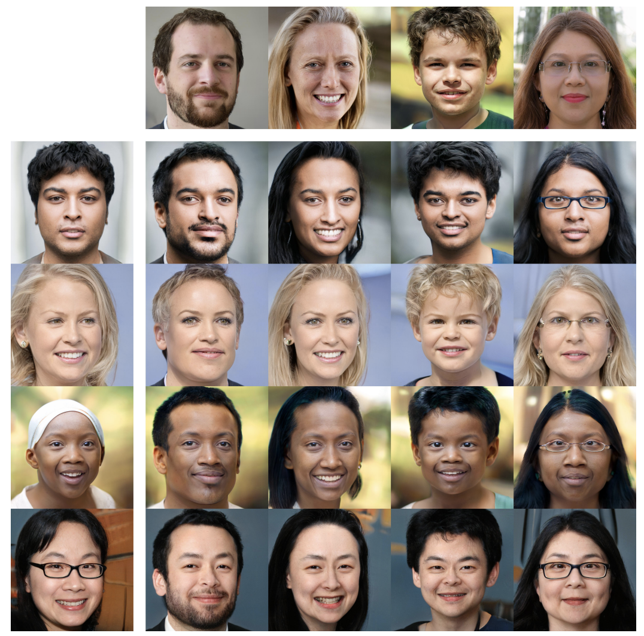
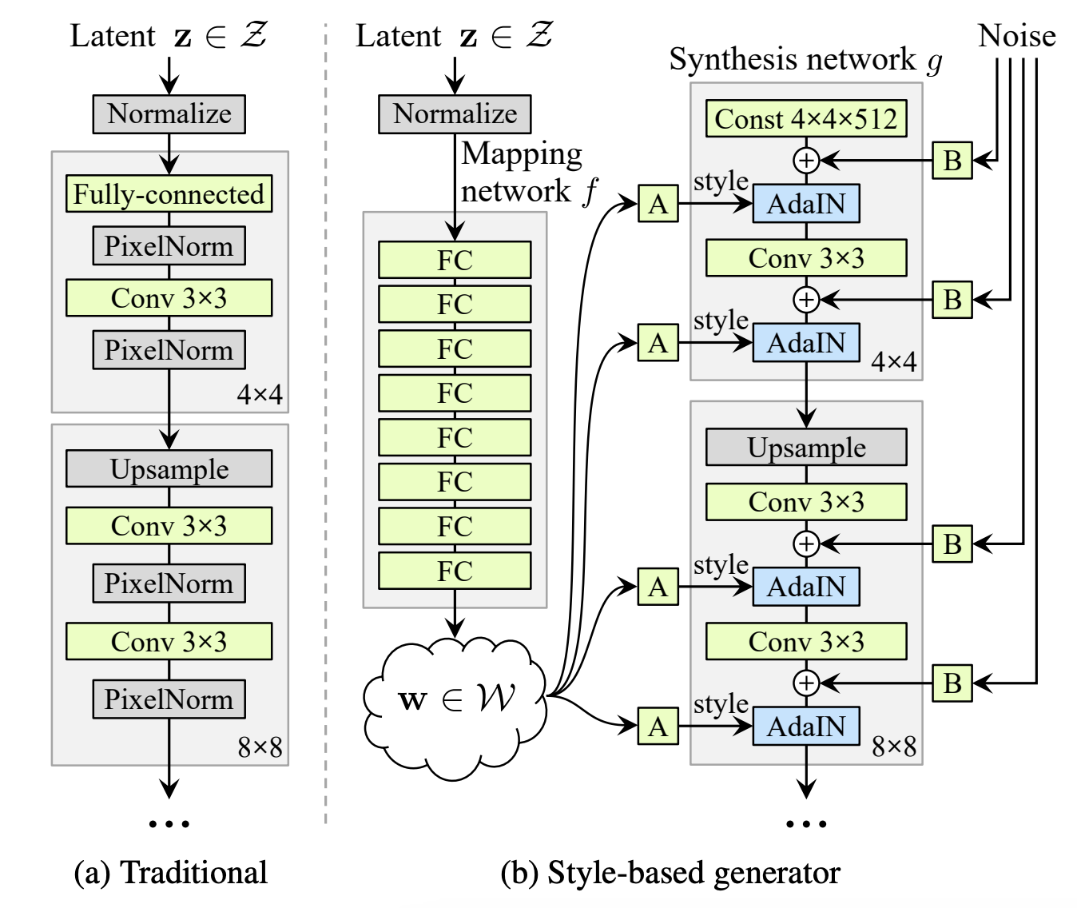
Modern GAN Approaches - StyleGAN
StyleGAN, developed by NVIDIA, this is a pioneering GAN architecture for generating high-quality, photorealistic images.
Unlike traditional GANs, StyleGAN introduces a style-based generator architecture that provides fine-grained control over various aspects of the generated image, from overall structure to detailed textures.
StyleGAN3 Mixing of styles
Style Control: Uses a mapping network to transform the input noise vector into an intermediate latent space, allowing manipulation of image styles at different levels.
Progressive Growing: Gradually increases the resolution of the generated images during training, enhancing stability and quality.
High-Quality Outputs: Produces highly realistic images, making it ideal for applications in art, fashion, and virtual reality.
Notes:
https://arxiv.org/abs/1812.04948, https://arxiv.org/abs/1912.04958, https://arxiv.org/abs/2106.12423

Slide 33
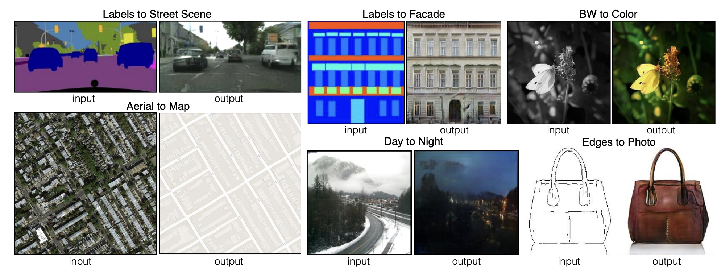
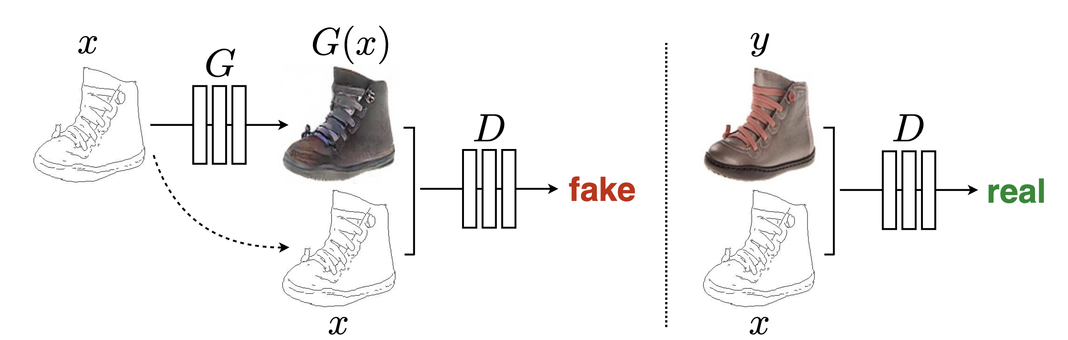
Modern GAN Approaches – Conditional GANs
Conditional GAN (cGAN): Targeted Image Generation
cGANs extend the standard GAN framework by conditioning the generation process on additional information, such as class labels or specific attributes.
This approach allows for more controlled and targeted image generation, enabling the creation of specific outputs based on the given conditions.
Conditioning Information: Both the Generator and Discriminator receive additional input data (e.g., class labels), guiding the generation process.
Notes:
https://arxiv.org/abs/1611.07004, https://arxiv.org/abs/1610.09585

Slide 34
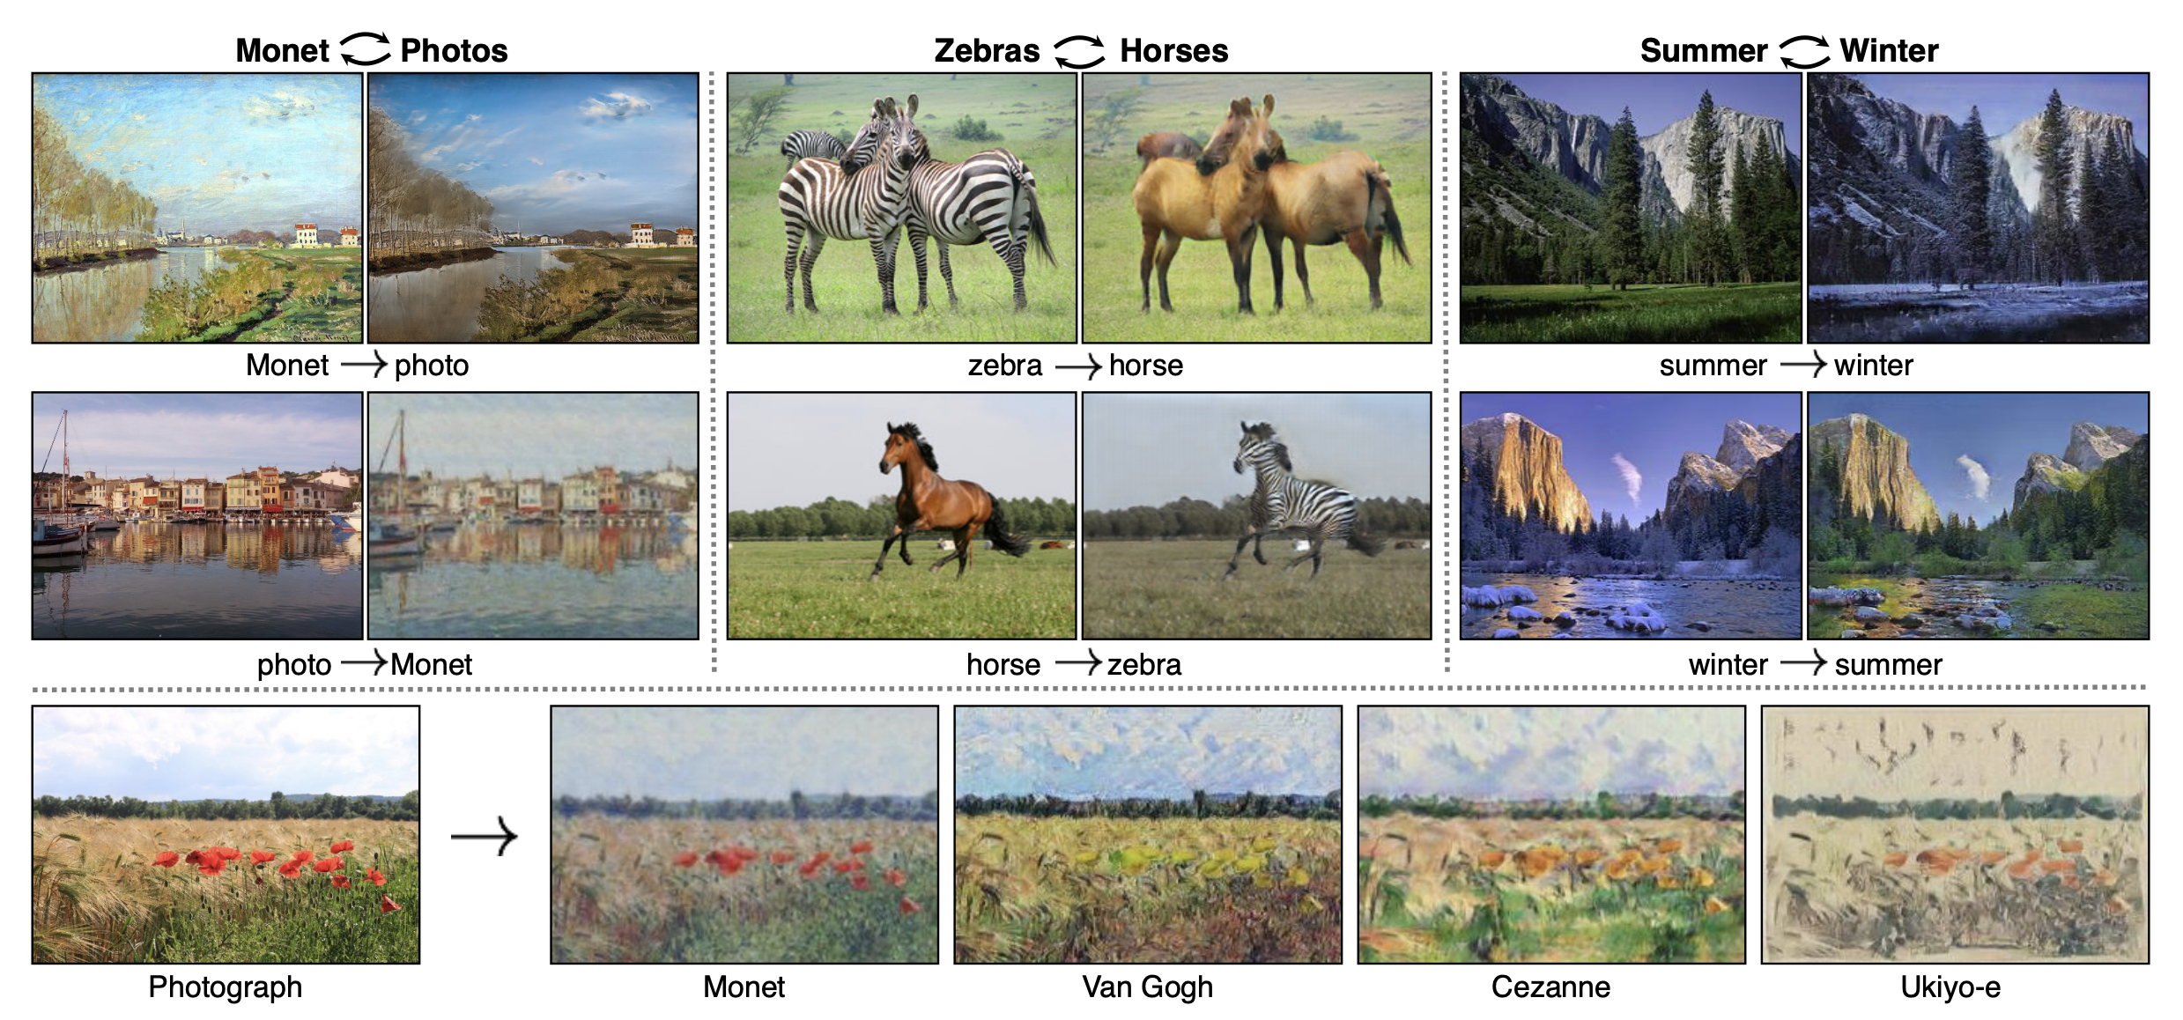
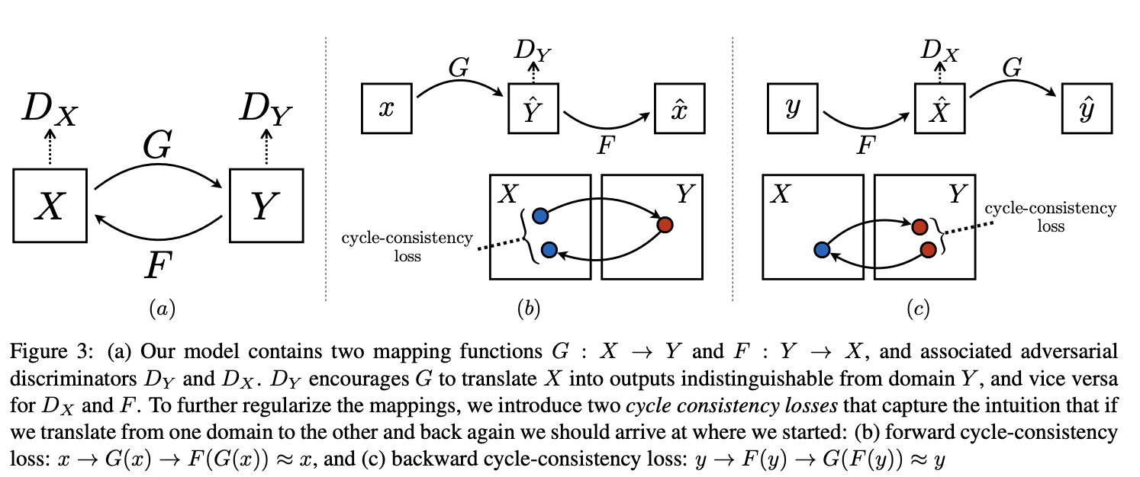
Modern GAN Approaches - CycleGANs
CycleGAN: Unpaired Image-to-Image Translation
CycleGAN is designed for unpaired image-to-image translation, allowing the transformation of images from one domain to another without needing paired training examples.
Cycle Consistency Loss: Ensures that an image translated from one domain to another and back remains unchanged, promoting stable and accurate translations.
Dual GANs: Uses two GANs to learn the mapping between the two domains, ensuring consistency and quality in both directions.
Notes:
https://arxiv.org/abs/1703.10593

Slide 35
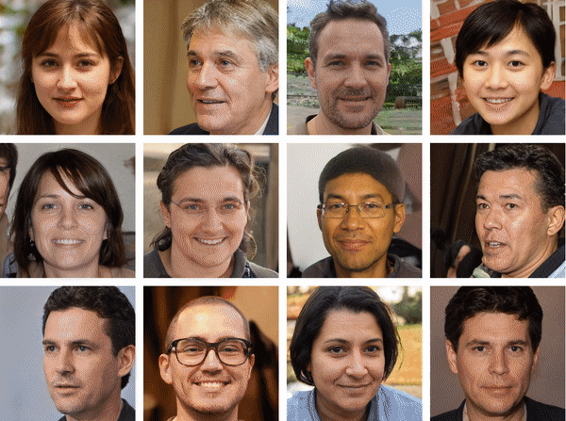
Wrap Up
Computer Vision and Generative AI
Today we reviewed some important computer vision topics
Introduced the transpose convolution and how it can be used to generate images
Explored Generative Adversarial Networks (GANs)
Discussed the issues with training GANs including mode collapse and instability
Saw some of the latest developments in GANs: StyleGAN, cGAN, CycleGAN
-----------------------------------------------------------------------------
In the next lesson we will start our discussion on diffusion models and how they can overcome some of the GAN limitations.
Notes:
https://paperswithcode.com/paper/stylealign-analysis-and-applications-of-1

Slide 36
Thank you!

